Slide 1
EveryOredigger Plans
Academic Year 24-25
Notes:
Each month of the 2024-2025 academic year (September through April), we’ll be highlighting a different dimension of well-being, providing resources related to the month’s dimension, information on well-being activities that students and employees can facilitate during meetings and details on programming happening that month in support of the theme. We’re also challenging you – our awesome Mines students, faculty and staff – to engage in some simple, yet meaningful, work to enhance that area of your well-being over the course of the month.

Slide 2
7 Months of Activities
September – Emotional
October - Intellectual
November – Social
December - Physical
January - Physical
February - Spiritual
March - Financial
April – Environmental
Notes:
These are the upcoming months in the semester, and their partnered dimensions

Slide 3
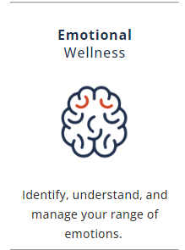
Emotional Wellness
Broad spectrum of emotions
Important to understand:
Why we feel what we feel
What precisely we are feeling
Notes:
Say: The language of emotion is limiting, and there is a broad spectrum between happy and sad and mad that we don’t typically name or claim as we work through our days. Whether we are on the happy side of life, or experiencing another emotion, being able to recognize and access why we feel that way, and what more precisely we are feeling, can help us understand ourselves and help others as well.

Slide 4
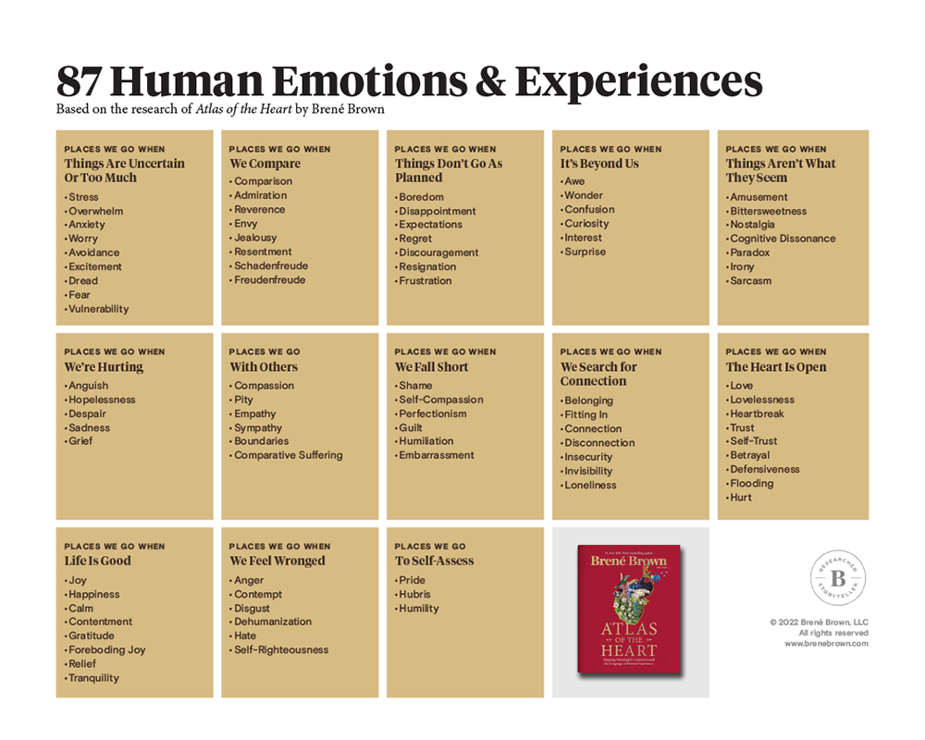
Brene Brown; Atlas of the Heart
Notes:
There is a broad range of emotions beyond happy, sad, mad, frustrated, etc. as you will see in the 87 Human Emotions & Experiences from Brene Brown’s book, Atlas of the Heart.
This helpful reference not only shares additional emotions that we may not name regularly, but also the context that might engage those emotions within us.
We’re going to use this information to work through an exercise…

Slide 5
Review the table Pick one category that you connect with the listed emotions more often than others.
Reflect with a trusted colleague on: - The nuances and small differences between each emotion in your chosen category, - How they each feel, and - How do you show up differently, with each of these emotions?
Share with a trusted colleague. Consider other languages!
Notes:
Say: Take a look at the 87 Human Emotions & Experiences chart and pick one category that you connect with the listed emotions more often than others.
Reflect with a trusted colleague on:
- The nuances and small differences between each emotion in your chosen category, - How they each feel, and - How do you show up differently, with each of these emotions?
Please be open to broadening your awareness and vocabulary.
Say: I’m going to ask you to talk with your neighbor or with someone in the room with whom you feel most comfortable. Please take 5-7 minutes to share with each other a little about the situation, and what emotions and experiences may have created that moment for you. Please be great listeners and don’t interrupt or affiliate with the situation. This is your time to listen. I will check-in with timing to ensure you each have a chance to share.
Say: It is important to note that this list uses English terms, and other languages may have a more perfect fit. Additionally, many languages have more specific words for the human emotional experience. Are you familiar with any examples of a different language that describes an emotion/emotional experience better than English?

Slide 6
Thank you!
Notes:
Debrief: Consider what you learned from the discussion.
How does the language surrounding emotions impact your lived experience?
Was this activity helpful? (Take a couple comments if offered).
Thank you for sharing with each other and for participating in this month’s EveryOredigger activity.

