Slide 1
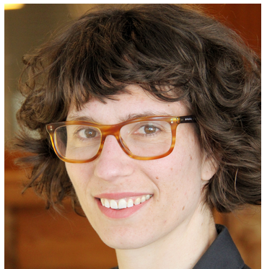
Immersive Gaming: Raw Materials for the Energy Transition Dr. Elizabeth Holley (Mining Engineering) Dr. Sara Hastings-Simon (Payne Institute, now University of Calgary)
Mining Geology Research Group

Slide 2
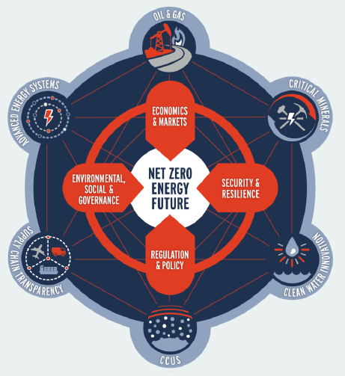
Why: Position Mines and its students as leaders in the energy transition
Policymakers have called for net-zero carbon emissions by 2050
Transition to a low-carbon future will be metal and mineral intensive
Mines students are uniquely poised to lead in this grand challenge
Aligned with Mines “Global Energy Futures Initiative”

Slide 3
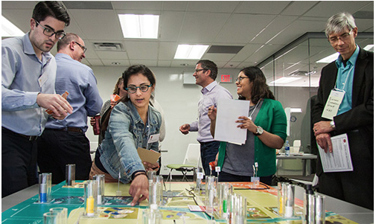
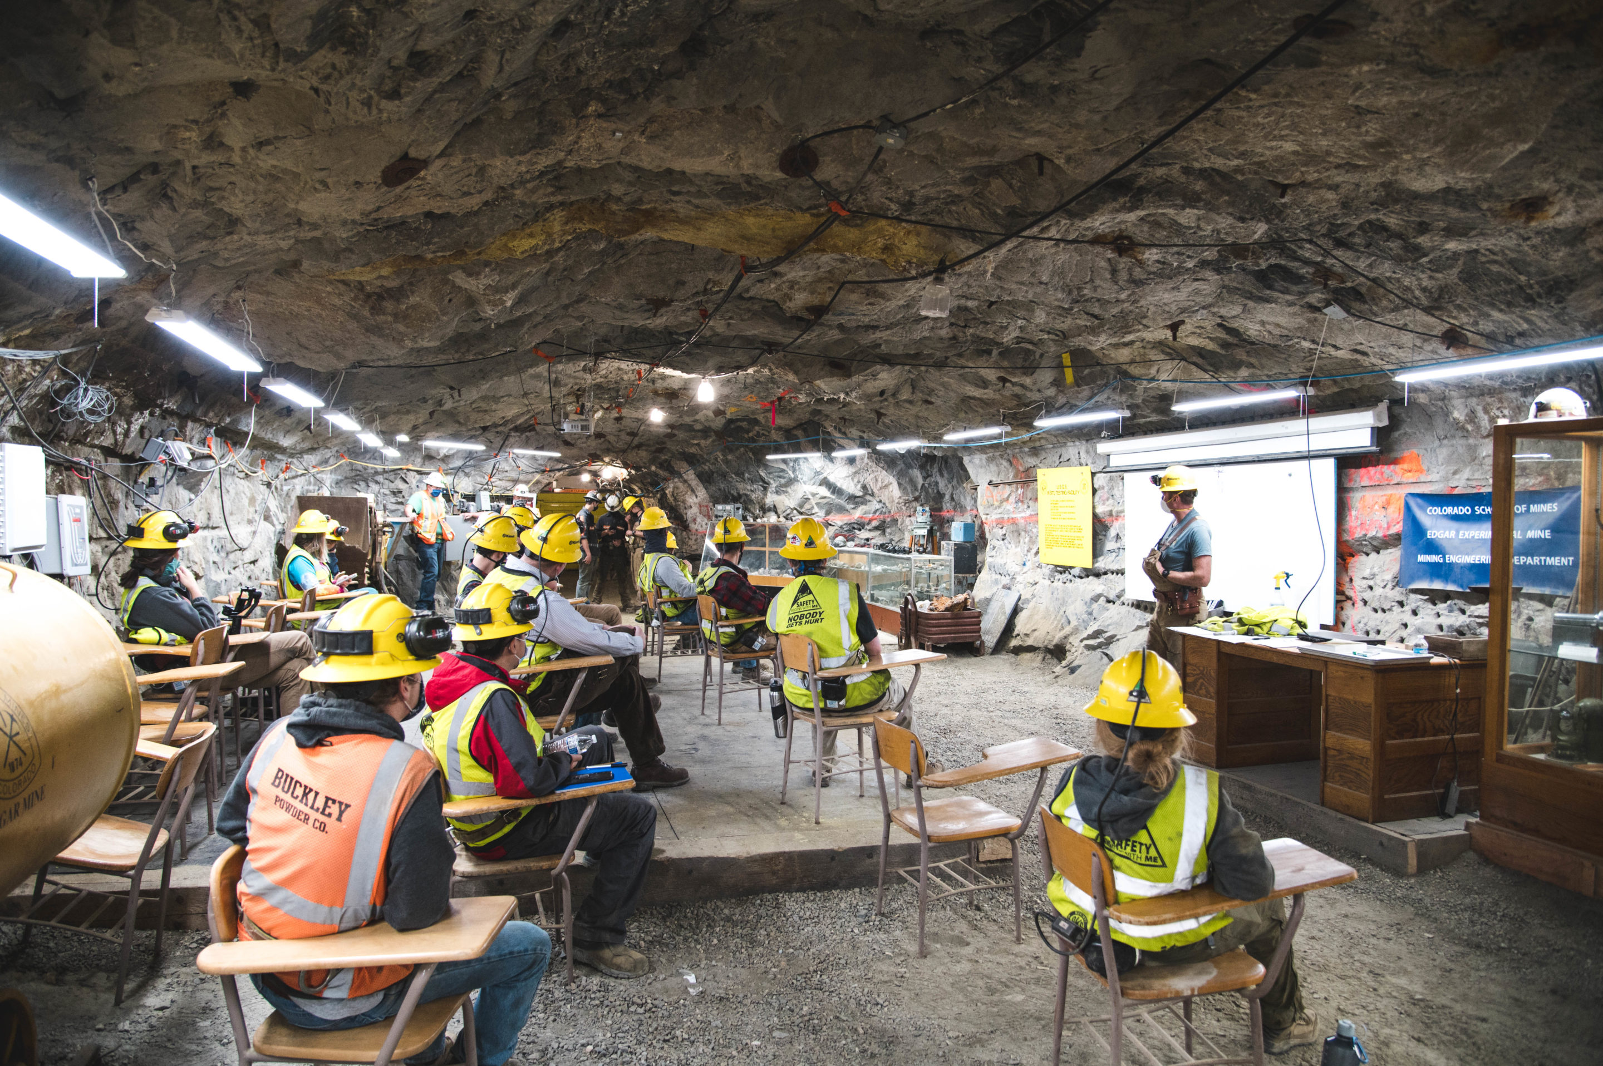
What: Mines students co-develop and facilitate an immersive game
For professionals in the mining sector
Similar to “Newtonian Shift”
Facilitated role-playing simulation
Unique business strategy workshop that helps organizations in the power industry plan for the energy transition
The Mines-branded game is focused on the raw material inputs needed for renewable energy
Critical Minerals, rare earth elements, etc.
Essential for EV magnets, wind turbines, solar panels…
Companies can play the game for a fee with Mines student facilitators
In the Edgar Mine or with a mine field trip

Slide 4
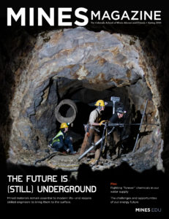
How: Partnerships, student research
Partnership with MaRS innovation accelerator
Founding partner of the Mining Innovation Commercialization Accelerator (MICA) Network
Team of Mines undergrads work with Holley & Hastings-Simon to develop technical content
2021 summer student gathered data inputs for the game
MaRS submitted a proposal to a corporate partner to expand technical scope and quality of the game
Opportunity for higher impact, more networking for Mines students
Refine scope, bring our data into the game environment
Deliver pilot version in Summer 2022

